Slide 1
Long live the audience! Jo Taylor Consultant at Morris Hargreaves McIntyre
Notes:
WIDE NOTES Charisma
Thank you for the opportunity of talking to you today. I am JT and I am from MHM we are a strategic consultancy and research working in arts, charitable and heritage sector etc. me perf arts – 18 years wmc. Wno. St gb, bath f
When we were first talking about this presentation we were talking about a title “arts marketing is dead – long live the audience”. As Chair of the AMA I feel less than comfortable declaring arts marketing dead. But I am not afraid to say that things really need to change.
So I am going to kick off the day with an assessment of where we are now.
I feel I should come clean and tell you I have a marketing background. But with apologies to esteemed marketing colleagues I am not a fan of all we have done and I think there have been some serious mistakes along the way we now need to review. So am going to question some assumptions and challenge some prevailing common practice.
It is difficult to do with out considering the landscape in which we find ourselves. And it’s hard to talk about that landscape without the over-riding focus being the cuts in public subsidy for the arts.

Slide 2
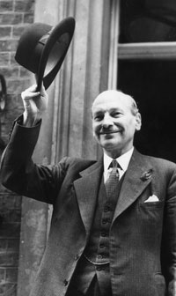
1947
Notes:
So let’s go back to 1947 – Clement Attlee – effectively established the principal of “arms length funding”
– so that the government were not making judgement on arts – they gave the arts funding to the Arts Council to manage.
Arts orgs would receive a cheque each year – regardless. One man and a dog. no questions asked – keep receiving the cheque
So we weren’t always reliant on the market and generating revenue.
But since then over years we’ve worked to hold onto sustained levels of funding under different gvts. We inhabit a culture where the popular media supports a philistine attitude, so we’ve had a constant battle to persuade politicians, policy-makers, decision-influencers of our value.
We’ve spent years trying to gain recognition of benefits the arts bring to individuals and to society - to prove their worth.
Alongside this – and in response to this – arts management , marketing has evolved.
.

Slide 3
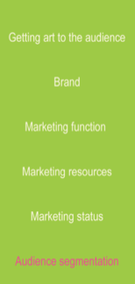
The evolution of
arts management
Getting art to the audience
Brand
Marketing function
Marketing resources
Marketing status
Audience understanding
Irrelevant
Notes:
3
So come the 1970S arts orgs were still product focused
If they like it they will come
We just tell them
So marketing was a low priority, low status and placed a low demand on resources
There was no need to understand the audience or their needs at this point – they were largely irrelevant

Slide 4
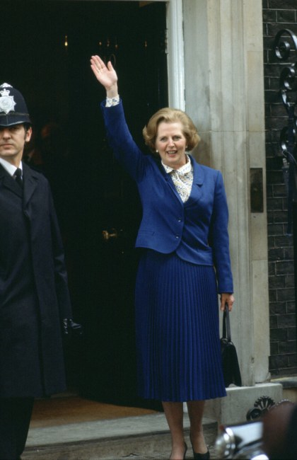
7 May 1979 Wave goodbye to your funding
Notes:
The last deep recession
Thatcher’s Conservative Govt got into power on the promise of cutting taxes – which resulted in drastic reduction in financial support for the arts
So - we began to measure the impact of the arts in economic terms – wanting to prove that we provided a benefit and to argue our case for funding
Incidentally – this was the last tie we looked to another country for a model which involved terrible funding – found USA – suggested that perhaps sponsorship could cover the funding gap – sound familiar?. But in a recession this doesn’t work. And Maria Miller is now saying philanthropy could double – Nicholas Hytner as already acknowledged the NT has only managed to double their charitable income because they are in London. Not a UK wide solution.

Slide 5
1988
The economic importance of the arts in Britain
John Myerscough
Notes:
5
John Myerscough’s study was able to provide the evidence that the arts contributed to the economies of regions by attracting tourist / providing jobs etc
Demonstrated how arts made a clear contribution to society because were instrumental in stimulating and supporting regional and local economies and their tourism industries
Fine if you are a large regional org.
However this left the majority of smaller local arts organisations and initiatives out in the cold: individual theatres, orchestras couldn’t argue they drew audiences into the region- they were there to meet the needs of local people; Nor could they argue drew additional income into the region. If locals people didn’t visit they’d simply spend elsewhere
Of course this did support case for investment in large capital projects, spawned by the newly launched National Lottery 1994

Slide 6
The evolution of
arts management
PRODUCT - LED
Getting art to the audience
Brand
Marketing function
Marketing resources
Marketing status
Audience understanding
Irrelevant
Media consumption
Notes:
6
Still product led but increased market dependence meant marketing teams now started HARD SELLING (never mind if it was actually what you suggested it was or what was appropriate to that audience member)
Problem = we took the money but didn’t deliver positive (or aligned) experiences – packaging up subscriptions to sell more.
Marketing had become an identified need. Budgets allocated for selling shows – tactical marketing plans were being implemented and we were trying hard to convince people of the benefits of going to see THIS SHOW. Still to this day most marketing suggests that THIS SHOW is the best thing you have ever seen (but really how many musicals can be the best one this year, since the last one – or an “unmissable global phenomenon”?!)
We weren’t retaining people. We weren’t reliable and as an information source we weren’t trustworthy.
SELLING in and of itself does not work.

Slide 7
The evolution of
arts management
PRODUCT - LED
Getting art to the audience
Brand
Marketing function
Marketing resources
Marketing status
Audience understanding
Irrelevant
Media consumption
Profile and behaviour of current attenders
Notes:
7
In the 1990s marketing become more stategically placed within the organisation with technology budgets allocated and status given to the marketers.
And for a while it did work as we better served our core….

Slide 8
The birth of arts marketing
Notes:
The birth of arts marketing as we know it today was born from the twin technologies of the time COMPUTER HARDWARD / BOX OFFICE SOFTWARE.
I remember my first install – FINALLY I had info at my finger tips about audiences
We were at this point at an advantage over Museums and Galleries…
A new Arts Marketing took up residence in performing arts – and has stayed there ever since.
Credit where credit is due. This helped us sell more tickets (for a while)
Simply through capturing booking data we were able to contact them to see if they wanted some more
Before that we’d had to rely on people scanning leaflet racks and looking through listings in the local paper. At its best hit and miss. Perhaps no wonder we’d got a bit shouty.
So the big idea now was that you would look at your booking system for those who had not booked. And you would target those who had not yet and persuade them to.
Those who had recently booked for Shakespeare were the most likely to do so again - or at a push you could convince them of the merits of another 18th c playwright.
And our bookers’ databases got bigger.

Slide 9
Audience under-development
Notes:
With limited resources the easy, obvious but potentially disasterous solution was to look to get the best response rates by mailing just those who are most active and most recent - the hot prospects. And for a time this worked. We got better and better at communicating with a small core of high frequency bookers.
Rinse and repeat this narrow selection process hundreds of times over several years and the result is chronic audience-underdevelopment.
We have built super highly engaged relationships with a tiny number of people – high frequency, committed, regulars
The massed ranks of “naughty in frequent, occasional or “lapsed” bookers have been left to drift – not deserving of our communications until eventually their non-appearance (is it any wonder?!) means they are even “cleaned” off our databases!!!!

Slide 10
Notes:
These were the people who have heard of us, know how to find us, showed an interest in us, voted with their feet by attending….
And there are loads of them – we were accellerating Pareto effect. If you don’t look after or look to these parts of your audiences the whole will shrink.
The value of these people is huge. They could be sitting in our seats – not frequently but there are lots of them.
The only way to get them to come back is to attempt to connect with them, to develop a relationship with them, understand their needs and motivations and sought outcomes and how we might be able to deliver them – not turn our backs on them and look for some “better” audiences.

Slide 11
Programming by numbers
Notes:
The other thing that happened in the 1990s - and for me this is the other really scary bit – audience ‘viability’ started to influence programming a– more of what sells well please.
We became risk averse. And this is my biggest fear for now with economic challenge – we need not to return to this.

Slide 12
Marketing tail wagging the artistic dog?
Notes:
This is the marketing tail wagging the artistic dog….This isn’t why we do it?!
We’re here because of our belief in the power of art. If we comprosmise our artistic vision for marketing – or anything else for that matter surely we are lost!? Marketing isn’t a necessary evil to counter artistic dreams – it should be a way of helping us realise them?
The job of the arts marketer is not to shape the programme. It is to develop an audience that can support our artistic vision – one that is ready and willing to follow and come on the adventure that our artistic director is leading.
In fact – audience relationships are so important – should they be left to the responsibility of the marketer or is it not important enough to be shared with the artistic leader?
Not apportioning blame. Have seen marketers who want to hold protectively onto “their audiences” and I’ve seen artists who don’t think they should worry about audiences

Slide 13
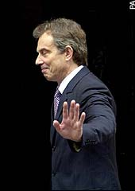
1997
Don’t thank me until you’ve read the small print
Notes:
Income a new govt - perhaps throw us off the scent further – Blair’s Labour shifted the emphasis from entirely focus on economic impact to include social impact of arts.
To assert relevance/ public value to be worthy of funding in this new era – arts orgs encouraged to demonstrate how contributed to achievement of other govt priorities: health; social cohesion; community well-being.
“its not just about the money - Show us how arts are also instrumental in helping meet other govt objectives Regularly reminded by policy-makers we had to compete for funds with such sectors - such as SPORT: Investment in S, it could be argued, saved country £Ms on NHS. Heart Attacks Clear statistical evidence of positive ROI
PROBLEM not why we were doing the art in 1st place. Our mission had never been to serve other other government departments in this way. We’d never evaluated ourselves rigorously enough (or against these objectives)….
And we were so busy trying to convince people of these arguments that we entirely forgot about our actual INSTRISIC worth.

Slide 14
2004
Art for art’s sake
Tessa Jowell
Notes:
Fortunately from 2003 Gvt departments and Local Authorities helped us out by recognising that ultimately: their role is to provide services and conditions that contribute to a quality of life for their citizens – and began articulating this in their policies.
Government started looking for Quality of Life indicators. This pushed open some doors for the arts to start finding the right language to make their case and to thinking about IMPACTS on audiences.
2004 then culture minister Tessa Jowell made a speech reasserting the principal “arts for art’s sake” – She called upon the arts to demonstrate the value to society – not just economic but also personal: challenged arts to reveal that the arts brought benefits ‘in and of themselves’

Slide 15
“Giving everyone the possibility of benefiting from what complex culture has to offer: an understanding of, an engagement with and the satisfying of the deepest of human needs”
Tessa Jowell, Government and the Value of Culture, May 2004
Notes:
So at last we were given permission to think about the intrinsic value of arts – which is why we do it
She also said “How, in going beyond targets, can we best capture the value of culture?”
Show how art provides benefits –‘in and of itself’
Quite like to remind current politicians we’d got to this point nearly 10 years ago!!!

Slide 16
The intrinsic impact of art
Notes:
So if we have confidence in the power of art to connect, engage and inspire people, we should hold fervently onto our artistic vision – not programme to what we think is already popular. And in fact, audiences want to be inspired by, and respond to, artistic leadership.
And if we want that art to have meaning and reach its potential, we must at the same time cherish, value and prioritise the intrinsic impacts these artistic experiences have on audiences.

Slide 17
Relationships not transactions
Notes:
This is about emotional relationships not transactional ones.
This isn’t planning based on whether someone “has or hasn’t booked for X, Y, Z” but with longer term ambition.
The holy grail is about on building RELATIONSHIPS with people – strong ones with enough people
Strong relationships are those where people TRUST and FOLLOW you. Do things BECAUSE it is YOU.

Slide 18
Box Office holds detailed information
Performances selected,
Art forms preferred,
seat choices,
frequency, party size,
spend,
planning horizons,
geography…
It describes current behaviour
Notes:
18
Let’s scoot back to the Box Office data…
Tells us all of this – which is great.
Flaw is that focus is on ticket sales NOT developing audiences – developing stronger, longterm relationships with larger numbers of people.
Just more effective comms with those we know most about
And what about those who haven’t “done” any behaviour in recent times – does that make them irrelavant and lost to us?
For some reason we are still enslaved to box office marketing today.
Box office describes current behaviour but it can’t explain the motivation behind that behaviour – it can’t tell you WHY someone did that

Slide 19
Its about understanding.
Audiences’ attitudes, perceptions, values, motivations, as well as habits.
Notes:
19
In the absence of this level of data, Museums and galleries on the other hand perhaps freer to think about what they need to know
While we have had our heads in our box office systems, they’ve had to ask “what do we need to find out”
– answer =
If you know what need they are looking to fulfil – what they seek to get out of engaging with us – you will know which combination of messages and products and services is going to be most effective in delivering that.
And they have gone about doing so – talking to and researching what makes audiences tick, what kind of experiences they want to have. And we have been working with them to measure and model this. Segmentation routed in attitude and motivation, not demographic or behaviour.
Perhaps the performing arts has some ground to make up… outside the box office system… or better still pulling this back INTO the box office system… (ask me about that later!)

Slide 20
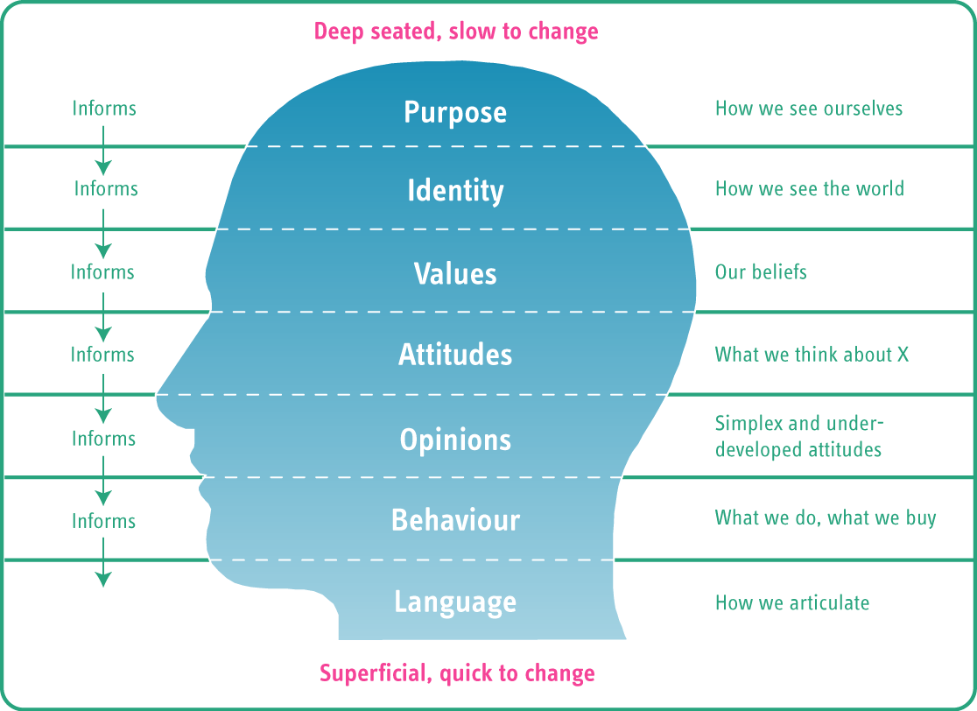
Notes:
20
Explain
This is also how you can influence them – not by knowing just WHAT they did but WHY
What we are actually trying to consider is two things
better understand what role does art play in their lives
How can we shape our relationship with them
We need to think about the levels of EQUITY we have within our audiences – the stake they hold in us

Slide 21
Brand equity: a definition
Functional brand measures
+
Brand Equity
=
Emotional brand measures
Notes:
Perhaps what we need to orchestrate, build, earn…. is brand equity.
Brand equity can be measured and therefore it can be grown
When we look at relationships based on our BRAND instead of our SALES
MHM We have identified 12 factors – 6 F and 6 E

Slide 22
Functional brand equity
Left brain – practical
May or may not get you noticed
Notes:
Dull but essential – used to be able to win on this – make all the difference – now they are the hygeine factors

Slide 23
Functional brand equity
Value for money
Reliability
Professionalism
Service
Facilities
Convenience
Notes:
VFM – not price – VALUE (£5 of rubbish is not value / £100 could be best £100 ever spent). Build by comm anticipation/ benefits before / deliver amazing enhanced experiences
R – full disclosure – do what you say you are going to do / don’t promise that which it isn’t
P – not shiny and slick – just come across like you know what you are doing
S – we know what good service is – and your audiences are most likely to come into contact with these staff than you so imperative they are well informed/ empowered
F – 1. to meet their needs – basic and practical 2. that are conducive to the art experience. Pyschological effect
C – Fitting in with their lives – opening hours/ ability to have a meal etc

Slide 24
Emotional brand equity
Right brain – emotional
Heart of audience relationships: perceptions, attitudes, feelings, imagination
Notes:
We can plan, build, orchestrate and practically grow these 6 features
We weight Functional and Emotional 2:1 in favour of Emotional.

Slide 25
Emotional brand equity
Loyalty
Trust
Preference
Willingness to follow
Sense of belonging
Desire to support
Notes:
L – simple and precised definition here = the longevity and constancy of the historical relationship and the strength of the intention to continue the relationship
T – are we believable, genuine, authentic and honest? Do we do salesy copy or describe what it is really like?
P – not just do they like use but do they actually choose us over others? – actively following to see what YOU do? Are they seeing something BECAUSE you programmed it?
WtoF – Holy Grail of AC. Will they do something because you suggest it?– Will they follow your lead?
SoB – not just like/ be in awe of – but feel part of. Feel ownership, connected, interactivity, relationship
DtS - orgs who share purpose inspire auds to help. Stuck in transactional rel– won’t see you as deserving support. Share your vision of impact on society
(JFK) = not what Org can do for them but what They can do for Org JFK

Slide 26
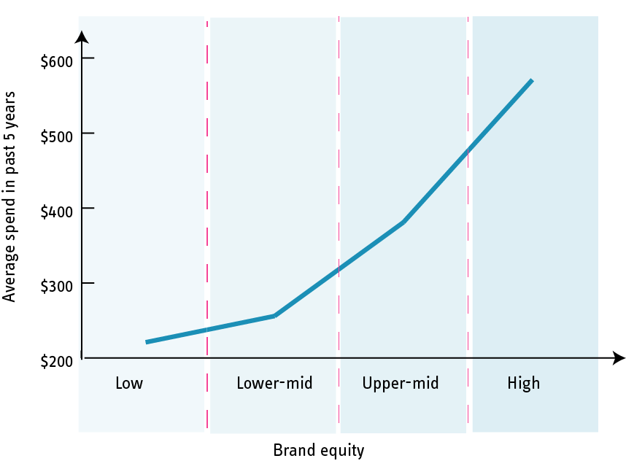
Brand equity: correlation with spend
Notes:
And if you need any more convincing here is a model from a client recently where in a survey we asked individs to score the org against the 12 brand equity areas
The higher their stake in the audience – higher brand score – the more they are likely to spend
If you were to ask your audience to rate you against these factors and look at your relative equity in different audiences – there would be a different way to understand relative value
This is what we are doing with clients now . AND then the client can work on the lower scores – earning more equity.

Slide 27
Why won’t audiences behave?
Notes:
So why won’t audiences behave?! Well, times are a changing.
Audiences frequency levels are a fraction of that of the dedicated audiences they are replacing (audiences who had little money, limited opportunities, a choice of two TV channels and no internet –
a concert or theatre performance could be the highlight of a drab week.
Modern audiences are both fickle and promiscuous – and this simply doesn’t serve the objectives of the traditional theatre marketing model.
They don’t come all the time - or to you every time….

Slide 28
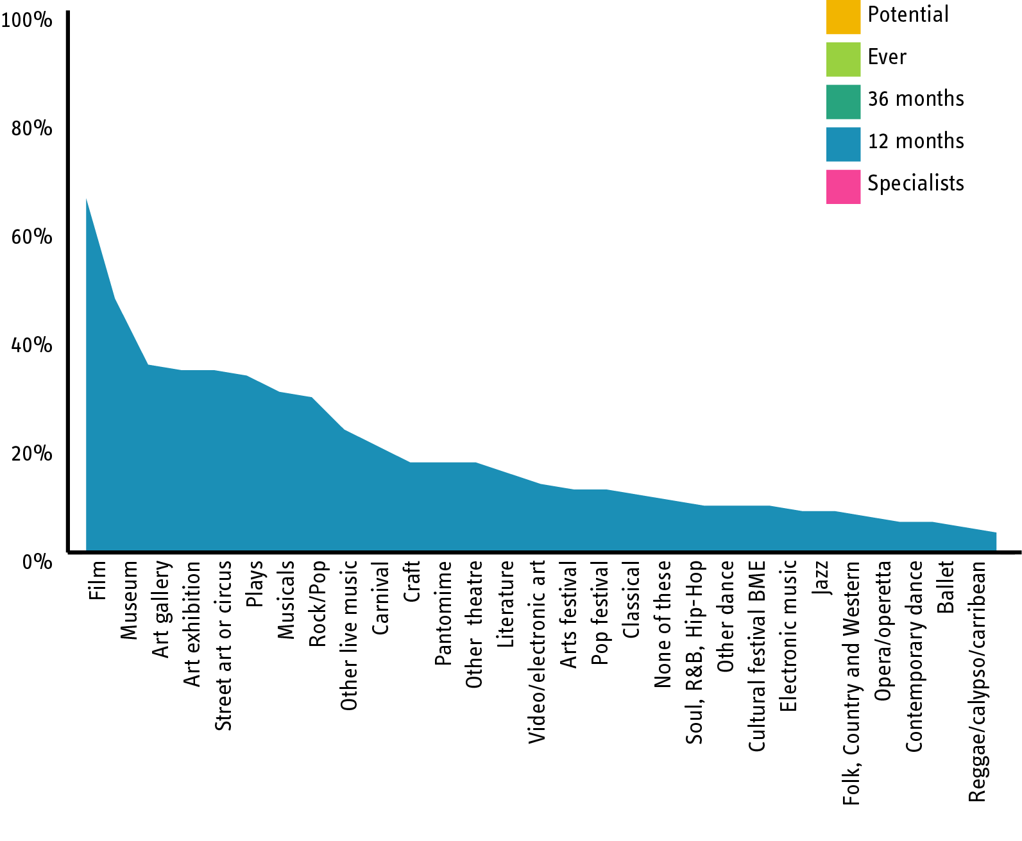
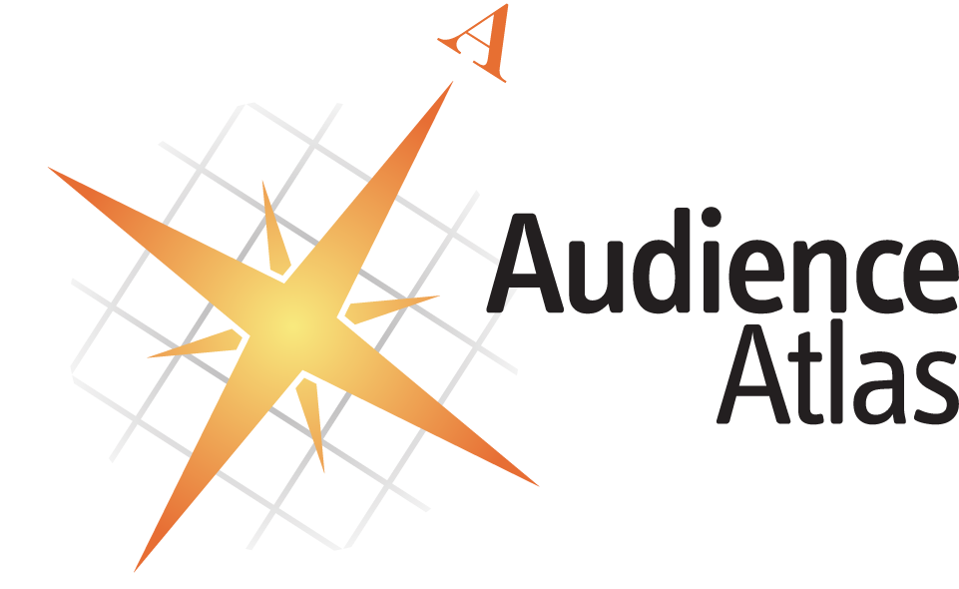
How big is the market for… ?
Notes:
What % of arts going audiences attend every year?
Actually 85% of people are in our definition of “in the cultural market
UK just under 50m people
(85% = just under 43 million)

Slide 29
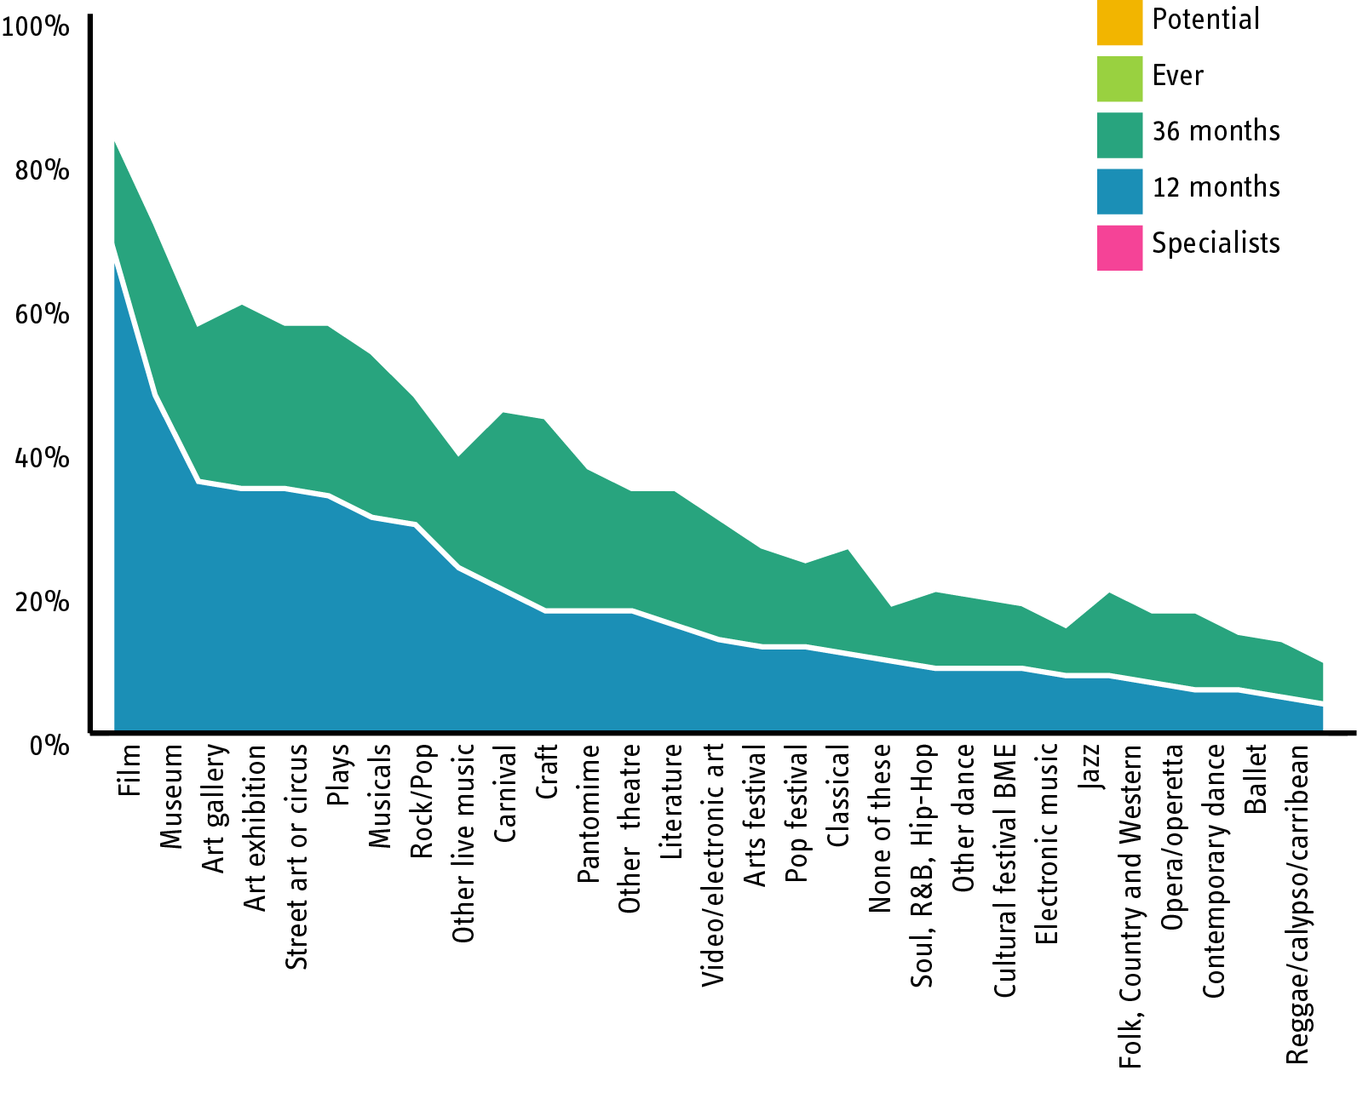
How big is the market for… ?
Notes:
UK just under 50m people
(85% = just under 43 million)

Slide 30
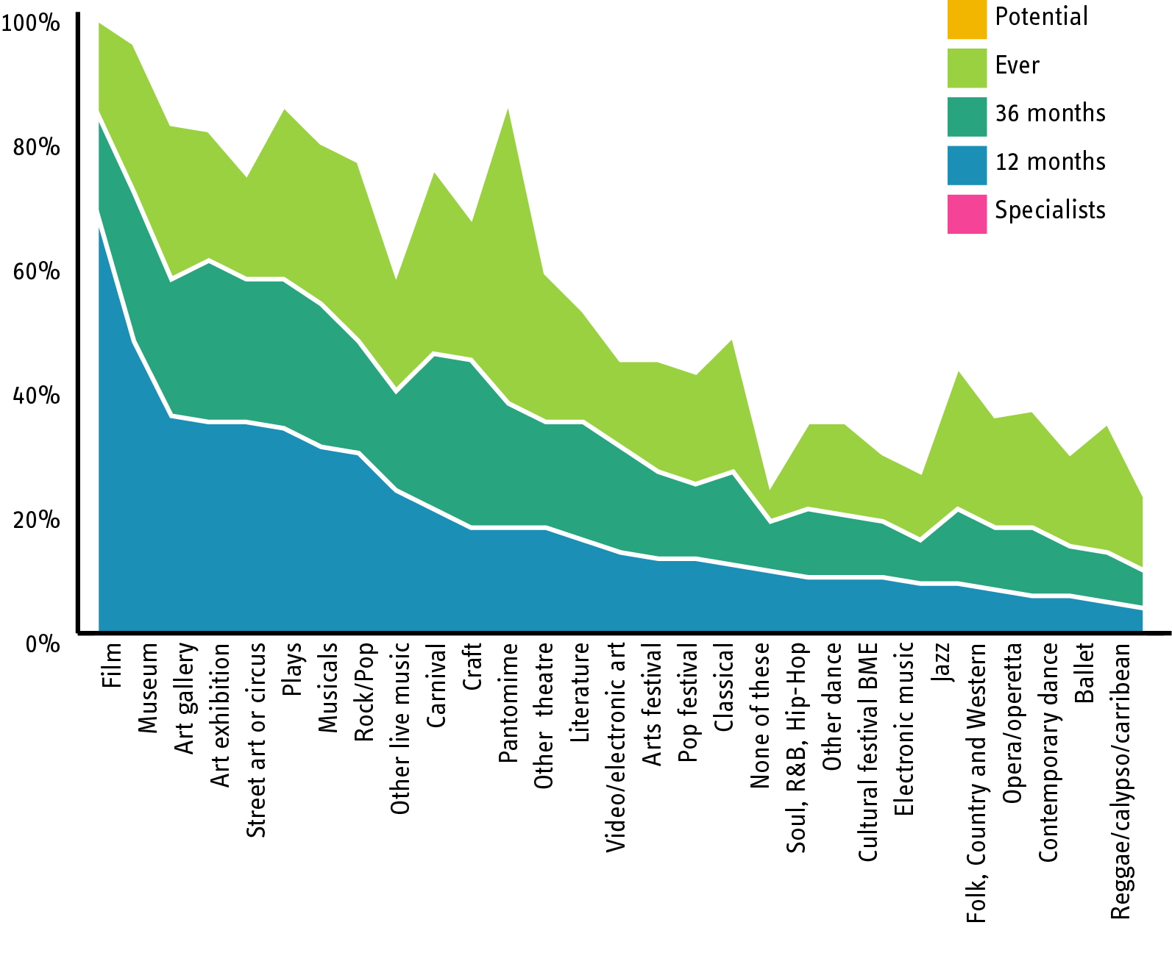
How big is the market for… ?
Notes:
UK just under 50m people
(85% = just under 43 million)

Slide 31
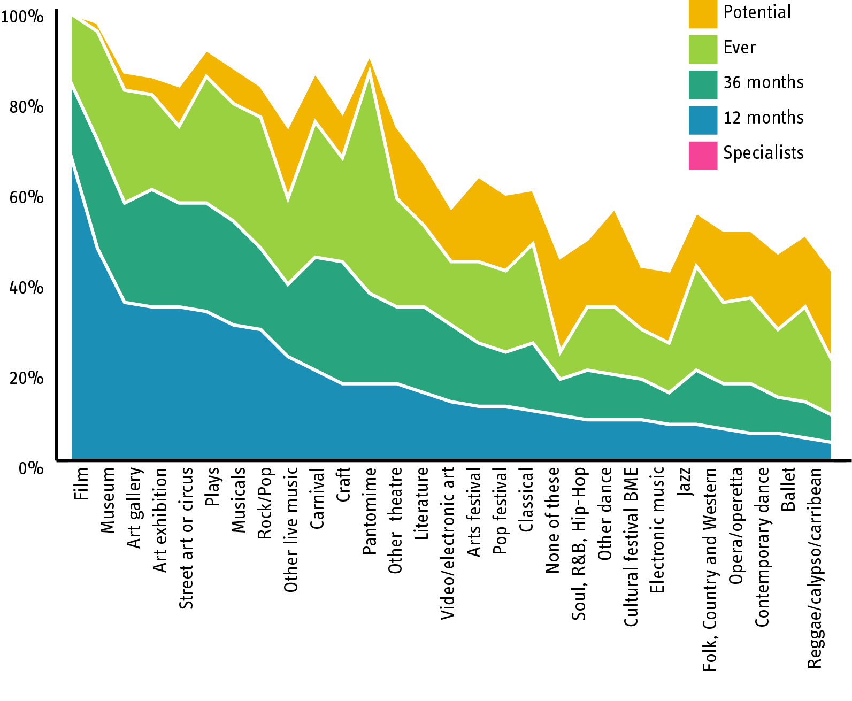
How big is the market for… ?
Notes:
UK just under 50m people
(85% = just under 43 million)

Slide 32
Market share or shared market?
Notes:
A feature of conventional arts marketing wisdom is to assert that promiscuity is BAD.
Monogomy is a construct of organisations seeking to serve their own needs as ticket sellers.
Vast amounts of precious marketing budget has been spent on trying to herd people into loyalty pens and defend market share. When the future is in fact a shared market.

Slide 33
“Every time the single-ticket buyer doesn’t buy, he strikes us a cruel blow, both financially and morally. His empty seat mocks our artists and screams its reproach to our promotional effort for its failure to entice him…
Ironically, the real victim is the recalcitrant ticket purchaser himself. If he could but understand that, by not coming, he has not permitted us to so inform him, to so inspire him, to so entertain him.”
Danny Newman, Subscribe Now, 1979
Notes:
The slothful fickle single ticket buyer as described by Danny Newman, Subscribe Now, 1979 – when I read this again recently I found it hard not to believe it was sarcastic!
This still pervades common practice in arts marketing…

Slide 34
We can’t stand in the way of democracy
Notes:
The fact is most people don't come very often. Because they have largely excluded us from their lives. And they are happy.
The assumption has been that poor, marginalised audiences are been excluded from our important artforms.
Actually if you talk to them, they don't feel in the slightest bit excluded. They don't want access. They simply don't see it as relevant to them.
They've got plenty of culture, often of their own making. Just not our particular brand of culture.
If anything, we are the excluded ones. The task, it seems, is not to rescue the stranded audience, but to make the stranded arts relevant to them.
Our audiences will be less inclined to worship at the altar of high art
and the artist is less likely to be regarded as a priest.
Consequently we have to offer a great deal more than just a passive consumer experience.
This democratisation of culture, and the profound shifts in patterns of production, distribution and consumption come as a big shock to any organisation that see themselves as the exclusive purveyors of culture.

Slide 35
Horizontal subscription anyone?
Notes:
The present day solution?
Diane Ragsdale has suggested horizontal subscription: to promote subscription schemes that cut across a range of arts organisations, including theatres, orchestras and galleries. This meets audiences’ needs for variety and choice and works with the diversity of cultural provision rather than against it.

Slide 36
Keep up, the audience are racing ahead of us…
Notes:
The BBC estimates that a new blog is created every second. 1.4 million UK pupils now have their own web page.
50% of 21 year olds in the US are involved in creating artistic content on the web including music, film, visual art, dance, and the written word.
Many audiences are no longer content simply to consume. They are increasingly actively engaged in making and distributing art to growing, discerning and endlessly diverse audiences worldwide.
And the blurring of boundaries between high art and popular culture means that increasingly anyone can claim to be an artist and present his or her work as art.

Slide 37
Audiences haven’t lost their imaginations
Notes:
There are great examples of organisations allowing a greater level of audience participation – from opportunities for self expression, through to public co-creation of the work.
Interactivity and co-creation ARE powerful tools to engage some of the audience, some of the time.
But it isn’t the only way – it is another string to the audience bow but not the bow itself
Arts engagement is deeply personal. And co-creation is not for everyone or every time
It is not fair to say that audiences of the future will only become engaged with art when they are physically involved with the creative process?
The digital generation is not enfeebled by the instant gratification of pressing buttons that they have lost the ability to think, reflect or concentrate. Or lost the ability to re-mix art and author meaning inside their heads while their body remains still? People have not lost imagination?

Slide 38
Never underestimate the intelligence of the audience
Notes:
So we believe successful organisations will be those who RESPECT their audiences Show a genuine CURIOSITY
In the past, artists, creative directors and curators have often proudly distanced themselves from audiences. And arts marketers have encouraged this – feircly defending their “expert role”
Engaging with the audience was a sign of dumbing down because audiences couldn’t possibly be as inventive, risk-taking or sophisticated as cultural producers.
This cascade of disdain has isolated the arts from the public and is still widening the divide.
But audiences are intelligent, informed, aspirational, creative, and increasingly articulate, discerning and open to risk – but not often enough credited as being so by the arts fraternity.

Slide 39
Intelligence & insight
Notes:
We believe there are two tools which enable arts organisations to meet these challenges:
• Intelligence: an awareness of the changing world around us that looks way beyond our own database, and
• Insight: an hunger to understand the needs, attitudes and motivations of our existing and potential audiences.
These are not just helpful in informing the transition we all have to make. They are vital drivers of a wholesale culture change that is critical for those arts organisations looking to a sustainable future.
Insight and intelligence should be the lifeblood of the 21st century arts org

Slide 40
We are all so much better than this…
Notes:
Instead of pull marketing which seeks to meet audience needs and educates and encourages people to take the initiative, make choices and create communities,
The arts has steadfastly practiced push marketing, which seeks to meet organisational needs by blindly pushing product into the channel.
Let’s not be SEAT SHIFTERS, desperately thrusting banks of unsold seats at people who have booked before and who, inexplicably, seem determined to ignore our direct mail “Dear ballet lover”
Arts organisations need to work with their audiences, rather than ‘do things’ to them. We need to open up, welcome in, collaborate.
We need to accept that we can be challenged and inspired by the audience’s creativity and that responding to that stimulus – whether artistically, or in our organisational culture, and especially in our marketing.
For culture to reach into people’s lives it has to be resonant and meaningful, and it has to add something that they can’t get from the host of other stimulation available elsewhere.

Slide 41
It’s ours for the taking…
Notes:
But this transition should not prove too difficult since current social trends are working in favour of the arts.
Patterns are clear. To generalise, in the 1980s the emphasis was on acquiring stuff that would make life better. We were consuming, accumulating things and measuring our happiness by how much we owned.
In the 1990s the emphasis shifted from blatant consumerism to buying a lifestyle – holidays, ideal homes – often unattainable dreams reliant on a level of disposable income that was equated with happiness.
Paying people to do the things we didn’t want to – resulting in massive expansion in services: restaurants, ready meals, nail bars, dog walkers. (
(In reality all this bought was more time to spend at work to pay for the lifestyle)
Now the aspiration is for ‘me’ time: the work-life balance. We hanker after more modest ‘perfect moments’ derived from authenticity (from the farmers' market to independent travel), community (Facebook, huge community fun runs) and treasured experiences. Together, these contribute to QUALITY OF LIFE

Slide 42
The arts can do all this…
Notes:
The arts can do that The arts can provide these moments – and probably better than any other sector. We can offer people authenticity.
The chance to get up close and personal with performers in intimate environments presenting us with an entirely new world view, emotionally cathartic moments, intellectual stimulation or just a really good laugh.
We stimulate social interaction: we can offer people the chance to join communities of interest, to engage in shared experiences, a sense of belonging, a sharing of ideas and creativity, affirmation and endorsement.
We provide perfect moments by the bucketful: altered state interludes; pure escapism; spine- tingling live experiences; nuggets of new and wonderful knowledge; unalloyed joy; celebration; unforgettable first dates. We can make people more interesting to sit next to at dinner parties: we can and do improve the quality of people’s lives.
Any multinational company even with their unlimited budgets would kill to have this kind of portfolio of experiential offers at their disposal. In their advertising, they go out of their way to manufacture elaborate fictitious stories of engaging human emotion to improve the appeal of anything from toilet cleaner to broadband.

Slide 43
21st century challenges
Societal changes
Explosion of information
Digital opportunities
Vast choice of leisure pursuits
Perception of relevance
Democratisation of culture and participation
Notes:
So the challenges we face include

Slide 44
Respond by being…
Vision-led
Brand-driven
Inter-disciplinary
Outcome-oriented
Insight-guided
Interactively-engaged
Personalised
Notes:
Holding into our vision and placing art centre stage
Understanding our brand – our essence – our DNA – what it is that is special and runs through OUR orgamisation
The end of silos – we are all responsible for audiences
We all should care about outcomes – as in impacts ON audiences. The outcome isn’t finished when the curtain goes up and we’ve got the final scores on the doors sales wise – that is when the outcome begins for the audience
Using audience intelligence and insight as the lifeblood for all functions in the org
Engaging audiences
Personlisation and flexibility

Slide 45
The evolution of
arts management
PRODUCT - LED
Getting art to the audience
Brand
Marketing function
Marketing resources
Marketing status
Audience understanding
Irrelevant
Media consumption
Profile and behaviour of current attenders
Notes:
45
So what’s next?
What do we do instead of that 1990s, narrow, traditional, inefficient, ineffective box-office marketing?

Slide 46
The evolution of
arts management
PRODUCT - LED
Getting art to the audience
Brand
Marketing function
Marketing resources
Marketing status
Audience understanding
Irrelevant
Media consumption
Profile and behaviour of current attenders
Needs, motives, responses of whole audience
Notes:
46
Well, our leading clients are already doing it.
It’s the shift from Product-led to Vision-led. Where we’re as interested in the impact of our art on audiences as the process of making our art.
And it’s the shift from Marketing to Audience-focus. To seeking deeper relationships with audiences rather than just pursuing more and different audiences.
To building communities around our work and curating conversations about it.
This uneasy stand-off between art and marketing has gone on too long. We need to break out of the silos and get everyone in the organisation to get excited about and take responsibility for audiences.

Slide 47
Let’s get creative (or die)
Notes:
Arts marketing particularly has to get a wriggle on: while the world is changing at a frightening pace, we can’t remain in glacial mode.
Shake off conservativism in the sector. I am sure lots of you in the room are and work with fantastic marketers but
What is particularly terrifying is that direct marketing campaigns aired in the 1980s are still being repeated now: audiences are still receiving the same letter.
– what is common practice should not be mistaken for best practice
We’re in danger of norming rather than innovating and continuing to use 20th century tools to meet 21st century challenges.
…This is the point where everyone reaches for Twitter and FaceBook. Yes, yes… Sure, there are all kinds of useful tools out there. And some of them are digital and online. But plenty of them are analogue and in the good old face-to-face world.
As is oft said, Facebook did not invent community. Twitter did not invent word of mouth.
Surely we don't need the web to discover that good dialogue makes good relationships?

Slide 48
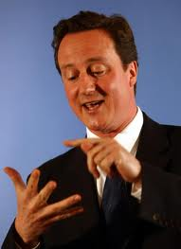
2010 Count it on one hand
2012 … and we’re not finished yet
Notes:
We aren’t about to find ourselves awash with money – foghorn warnings of further cuts to the arts are enough to depress the most optimistic of us.
Fantastic response from leaders of regional theatre in the sector and the likes of Danny Boyle demanding we need something beyond Wetherspoons and John Terry – something to believe in.
I agree.
But whatever happens we have to plot ourselves a course for a healthy future.

Slide 49
Don’t wait to be asked
Notes:
Our traditional set up was developed in very different times, for audiences very different from those we address now.
If we are to adapt at the speed set by the fast-changing world around us, then audience insight is the catalyst we need to help us match that pace of change.
At MHM Every time we speak to audiences, in hundreds of focus groups and thousands of interviews every year, we hear the same message:
that the arts can and do transform people’s lives.
The same passions that drive us to work in the arts, drive people to engage with them. The deeply-felt personal, life-enhancing outcomes are not just our own fanciful constructs: they are real and emerge repeatedly and unprompted from peoples’ lips.

Slide 50
Facing forward.
Notes:
Thinking about this presentation, it would be easy to join the glass is half-empty brigade and wallow in the misery of lack of government support.
Or I could have joined the glass half full brigade and cheerfully exhort you to be more efficient – carry on but do more with less – make budgets go further with digital tips and tricks.
But I’ve chosen the long view. We need our management and our marketing to be as creative and ground-breaking as our cultural production.
We need to speak to people, listen to them and treat what we hear with respect. From the insight this conversation provides, we can liberate ourselves, to make the changes necessary for a sustainable future where our impact is truly felt and widely recognised.
Arts organisations in the UK must shift from assuming that we deliver art to a passive audience,
We must personalise services and find new ways to engage with the public
We must rid ourselves of any illusion that everything we need to know is contained in our box-office database.
There are so many amazing and creative people in this room – the opportunity to collaborate and share ideas is a fantastic one. I really hope that you make the most of today (sure you will) and use it and each other to plot the direction of travel – and hopefully understanding how we got here will help in that.

Slide 51
Jo Taylor jo.taylor@lateralthinkers.com @JoeyTaylor
Notes:
Thank you.

Slide 52
“Something in our cities and towns… that isn’t Wetherspoons and Walkabout pubs and Mario Balotelli and John Terry… something decent to believe in. Something good and nourishing for us all”
Danny Boyle, November 2013
Notes:
Despite Danny Boyle’s pleas to the government to realise that the arts provide society with
"And it's something in our cities and towns... that isn't Wetherspoon's and Walkabout pubs and Mario Balotelli and John Terry and people like that." These local beacons of the arts were, Boyle added, "something decent to believe in. Something good and nourishing for us all
We must transform the philosophy, ethos and values of their organisations – being prepared if necessary, to address their structure and performance measurement systems.

